Slide 1
Popular Baby Names of the last 60 years
Amber, John, Marc, Kenny, Marie

Slide 2

Collecting and Cleaning the Data
Where we found it and what we did

Slide 3


Data Prep
Collected name data from the Social Security Website (https://www.ssa.gov/OACT/babynames/limits.html)
Downloaded as txt – converted files to csv.
(Shout out to Kenny) – cleaned up, compiled files with Python
(Shout out to John Ro (and Eric Kleppen)) – took the tables put it into a sqlite file and the Flask App.

Slide 4

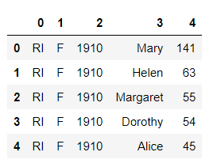
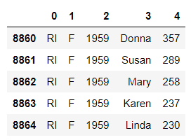
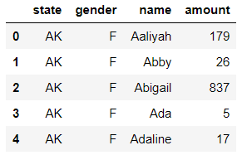
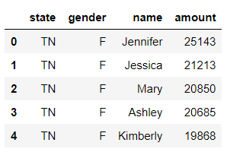
Data Prep (Python)
1) Convert text to excel
2) Read the data into a data frame
3) Filter the year
4) Merge the states
5) Split the data by gender
6) Group by state, gender, name
7) Top five names per state
8) Merge the datasets back

Slide 5
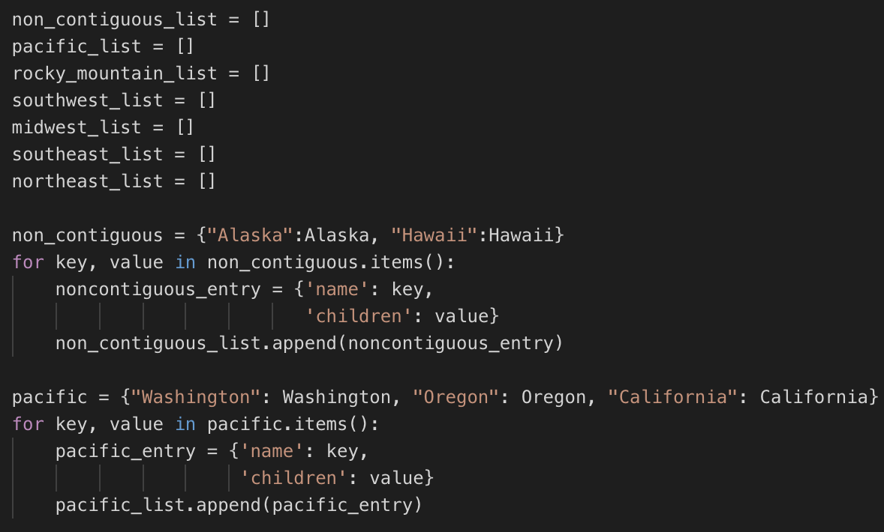
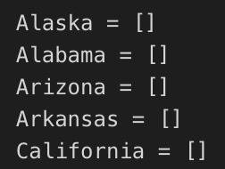
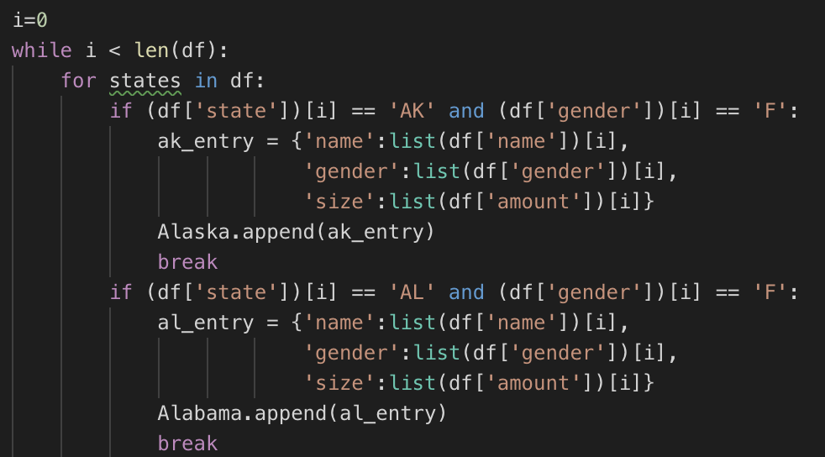
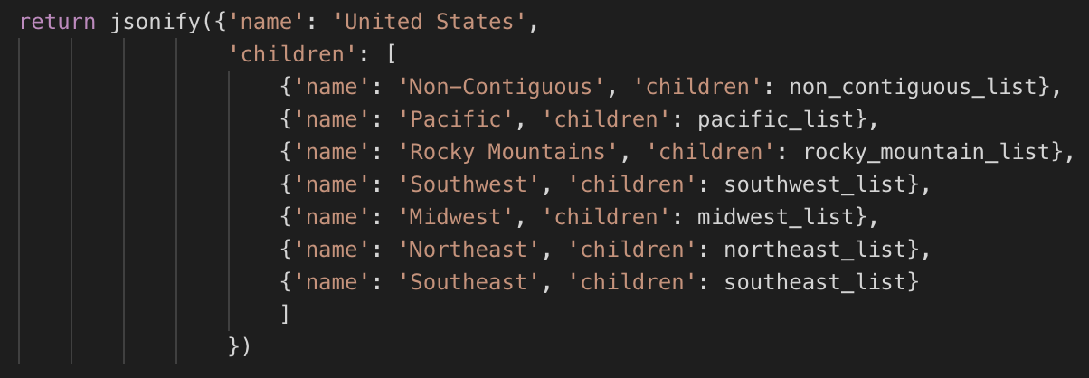
Data Prep
Formatting the JSON

Slide 6
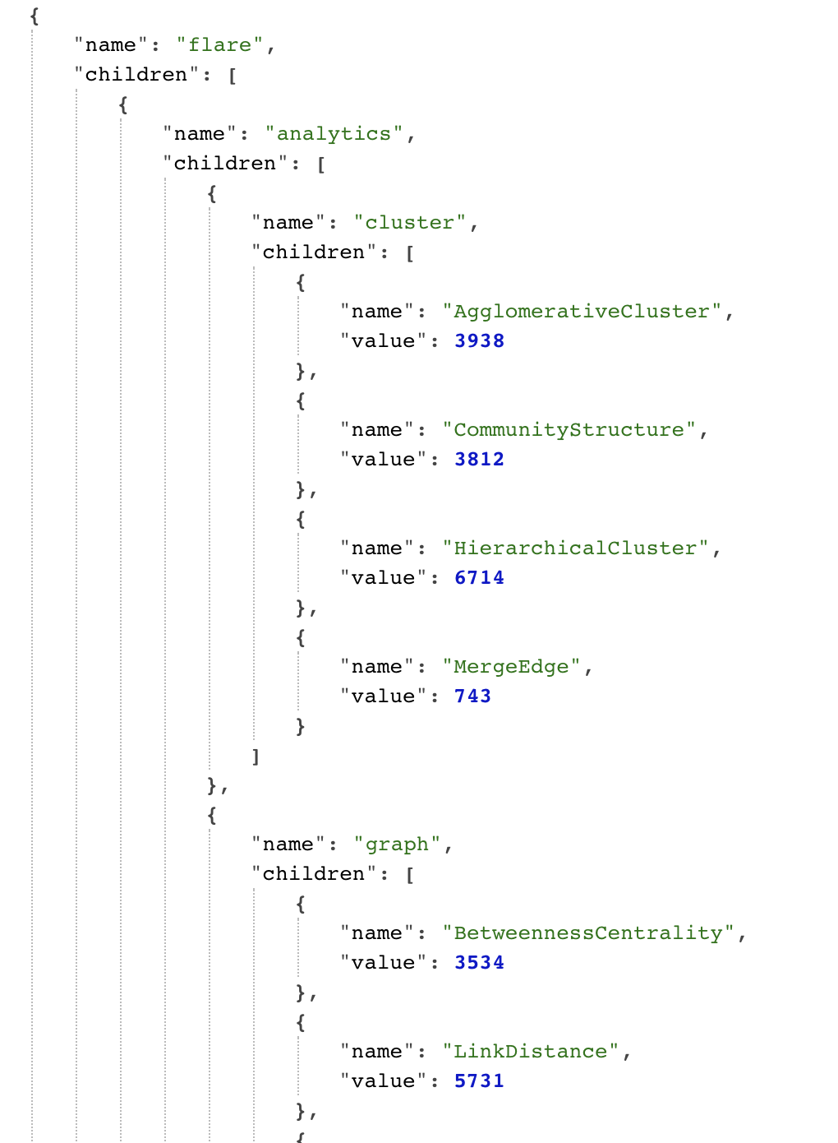
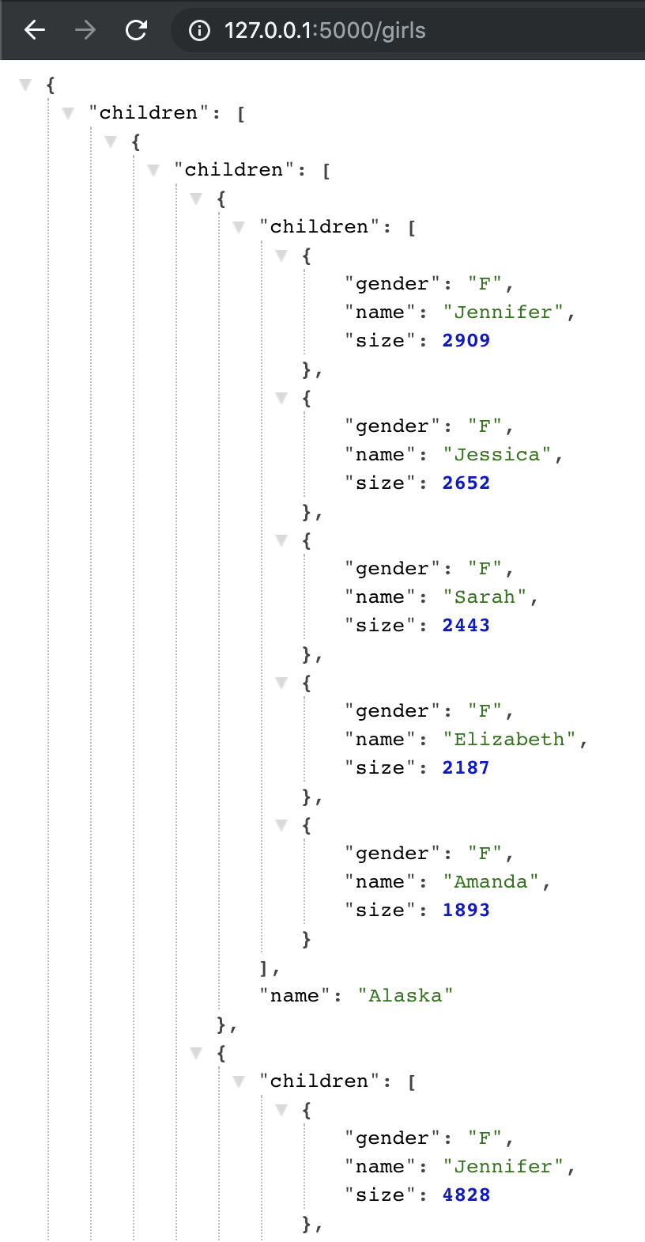
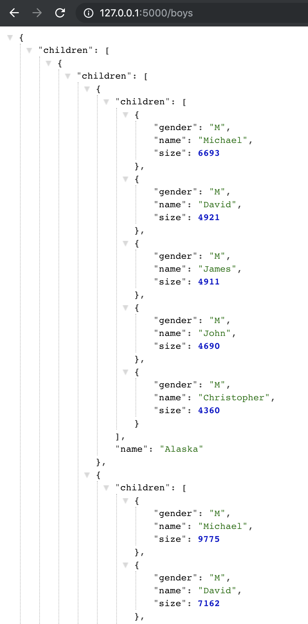

Slide 7
Visualization
Creative D3 Project: Zoomable Circle Packing

Slide 8


Slide 9
JavaScript Library
Magic.

Slide 10
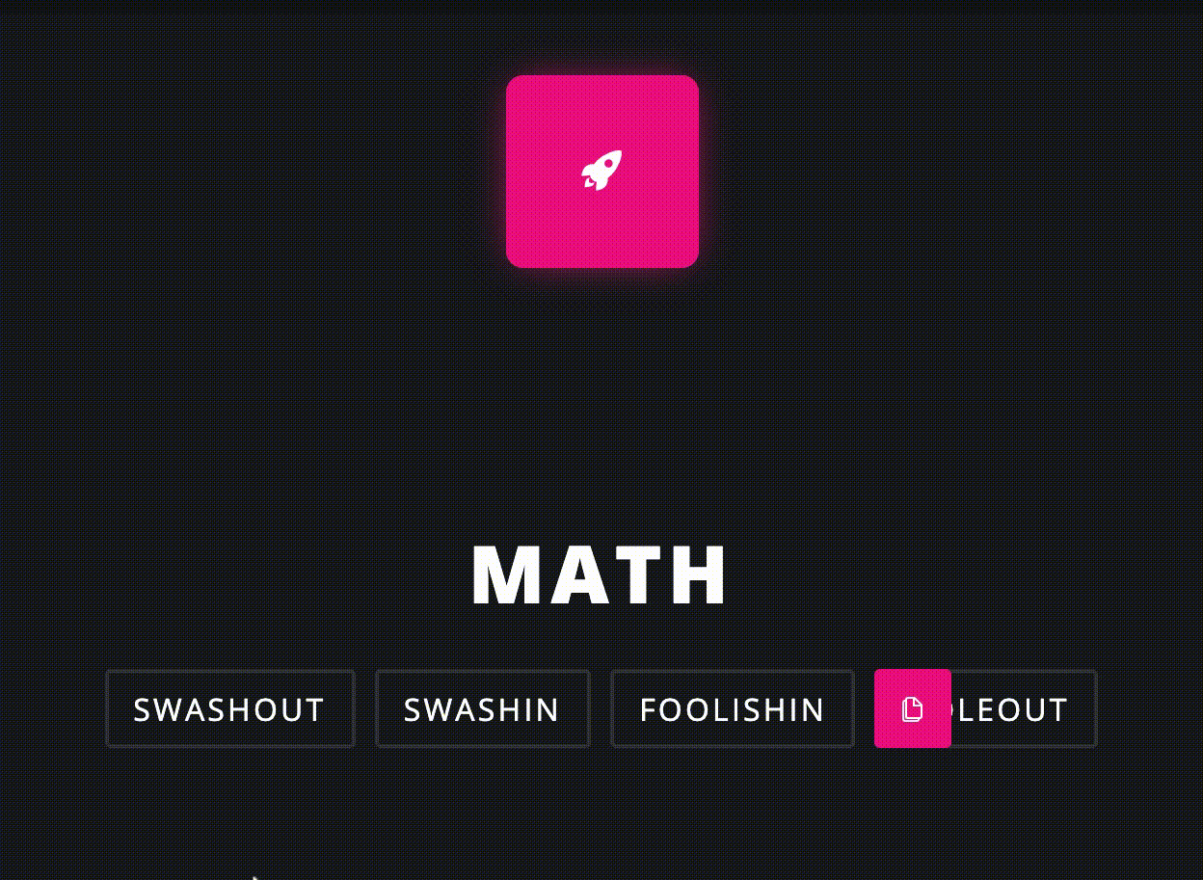
JavaScript Library: Magic CSS
This library gives you lots of transition options!!
url:
www.minimamente.com/project/magic/
Figured out by Marie and Marc

Slide 11
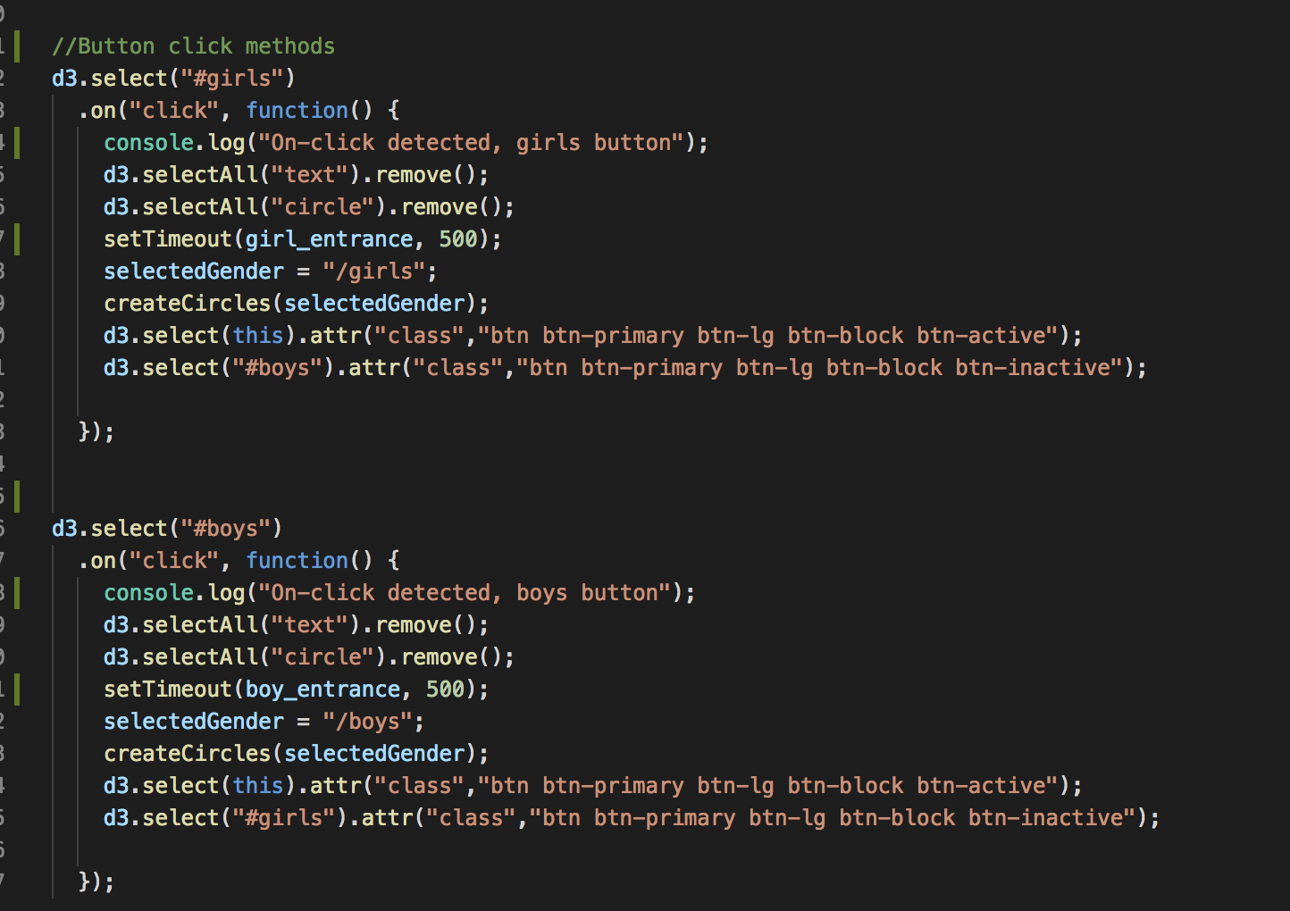
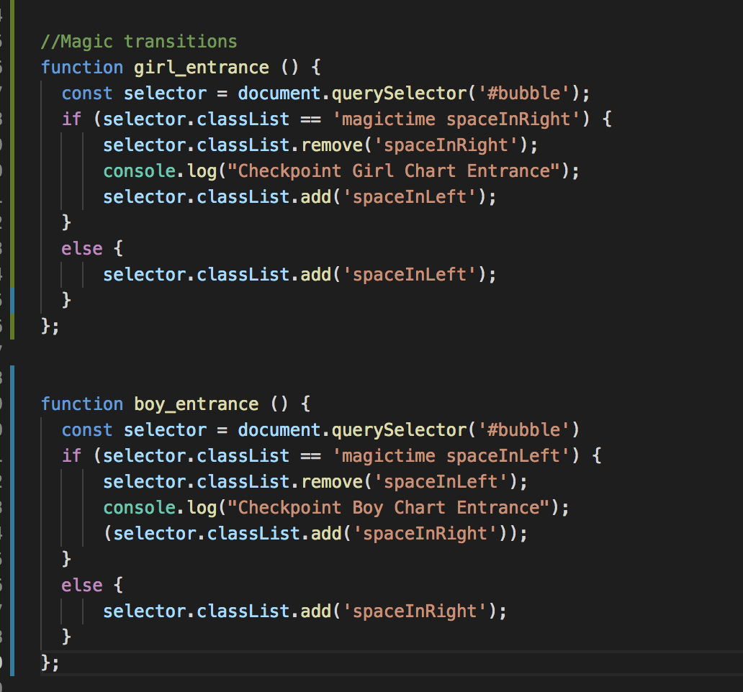
The code behind the magic (calling the transition)

Slide 12
The Dashboard
Styled by: Amber

Slide 13
